Slide 1
Economic Update: Oil & Gas

Slide 2
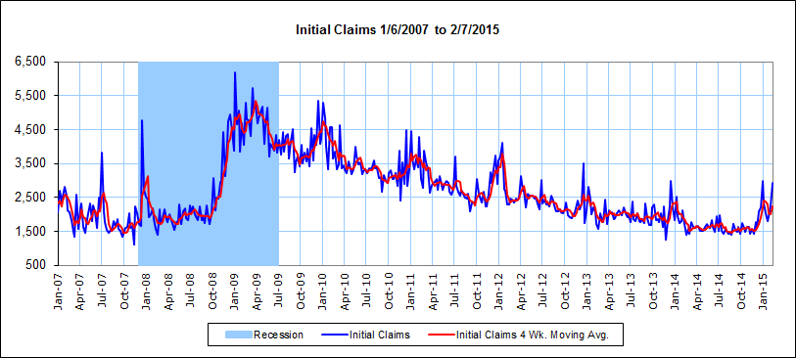

Slide 7
